Slide 1
Manhattan Restaurants Reviews on Yelp
Web Scraping
EDA
Sentiment Analysis
Text Classification
Hongyi Chen
Tingyi Lu
Xiaomin Yang
Junhan Zhou
Notes:
––=–––––––

Slide 2

Content
Introduction
Web Scraping
Exploratory Data Analysis
Data Visualization
Text Analysis
Modeling
Model Compare
Results and Implications
Future Work

Slide 3
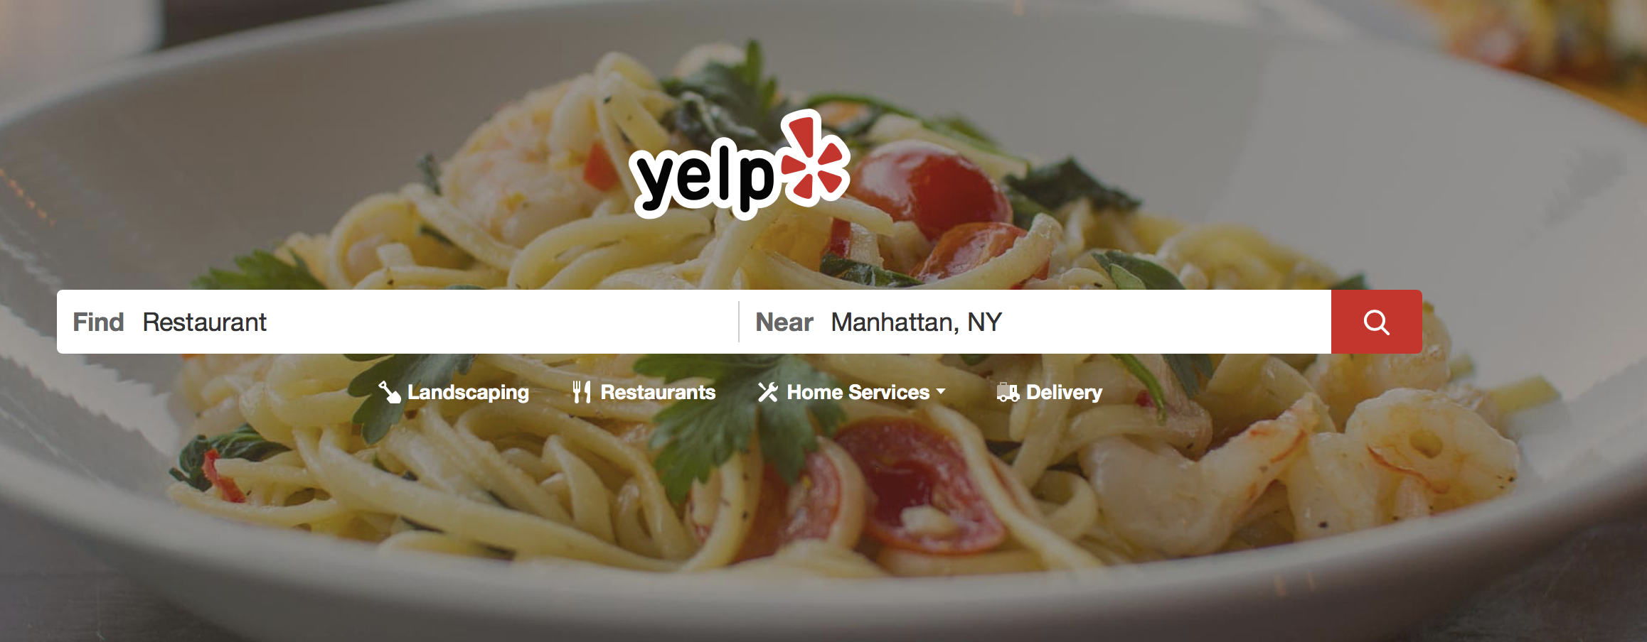
Introduction
The popularity of restaurants can be evaluated through all kinds of social medias, which not only can provide suggestions for customers on restaurant selections but provide guidance for restaurants owners on making profits.
Thus, in this web mining and analytics project, we obtain restaurants data from Yelp and tend to evaluate the popularity of restaurants in Manhattan area.

Slide 4
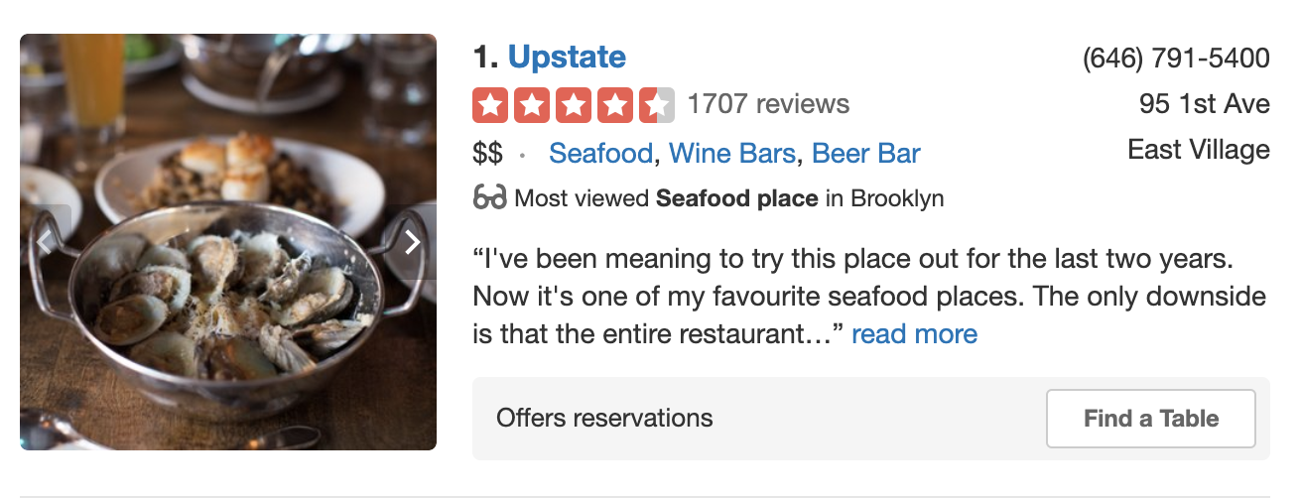
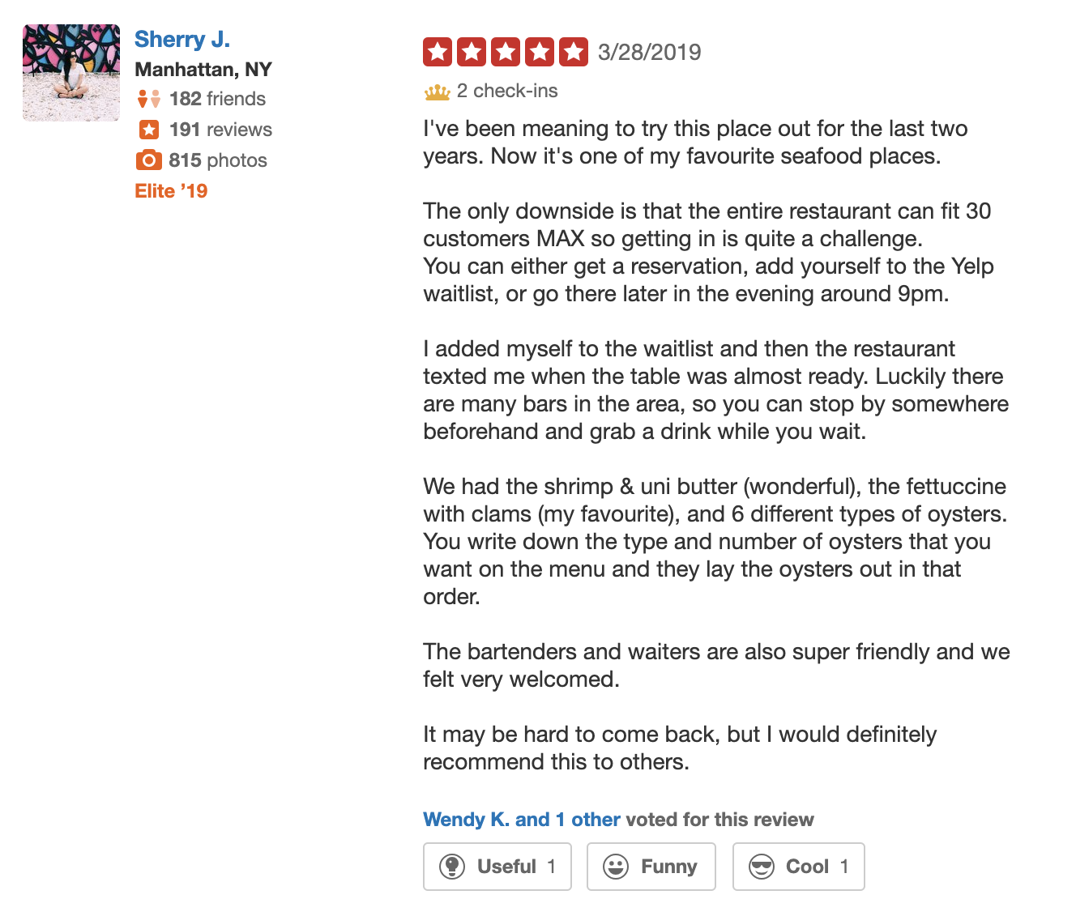
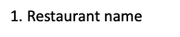
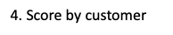
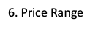
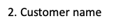
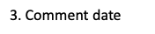
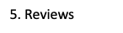
Web Scraping
https://www.yelp.com/search?find_desc=Restaurants&find_loc=Manhattan%2C%20NY

Slide 5
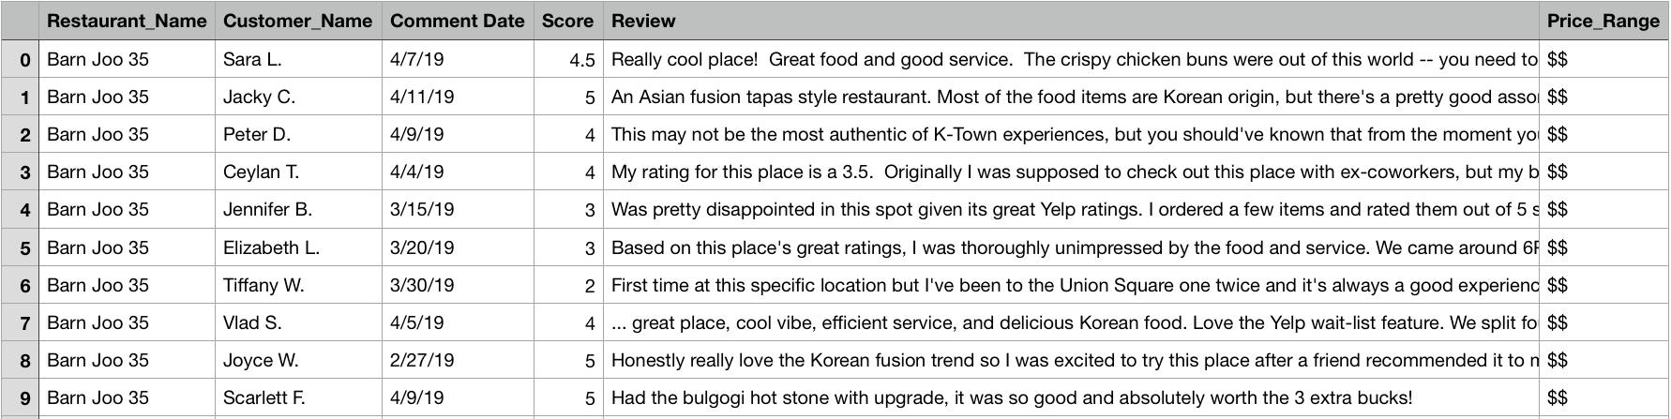
Data Scraping
This dataset contains 3,413 rows with 6 attributes: Restaurant name, customer name, comment date, score, review and price range.
rawData.csv

Slide 6
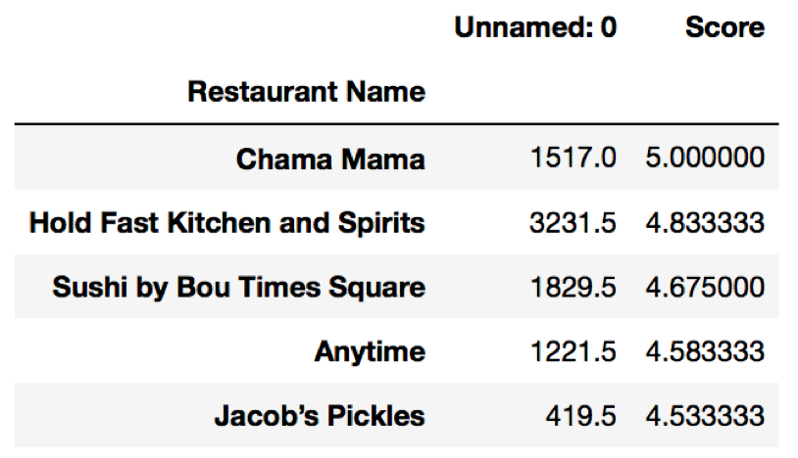
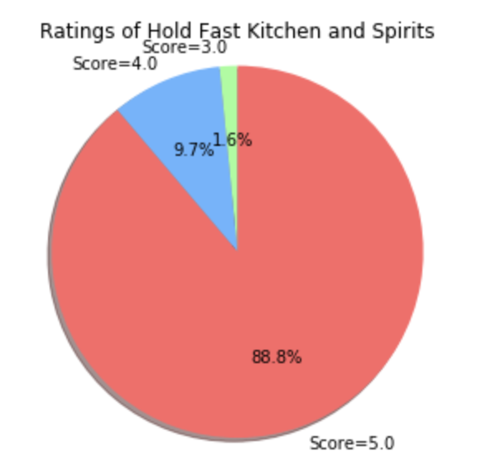
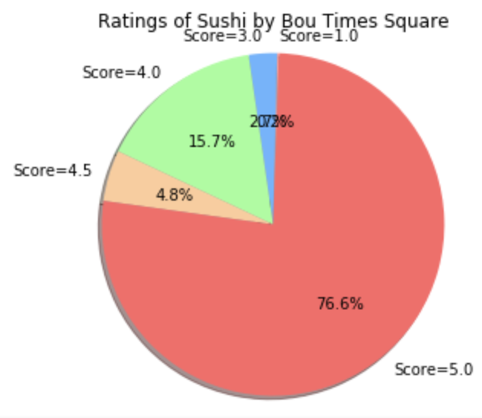
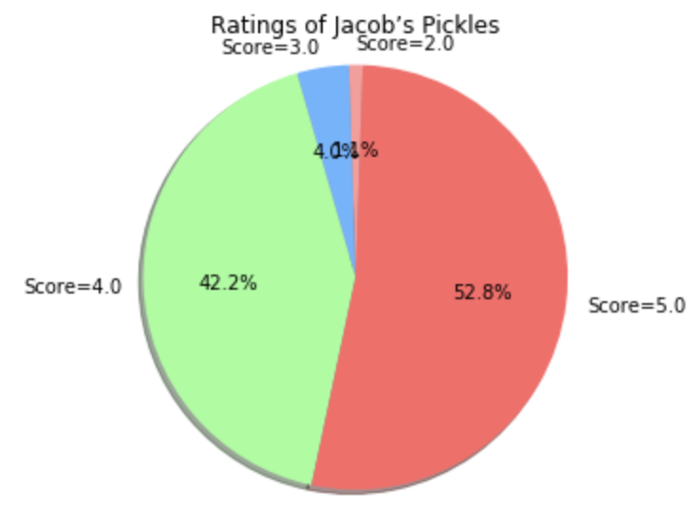
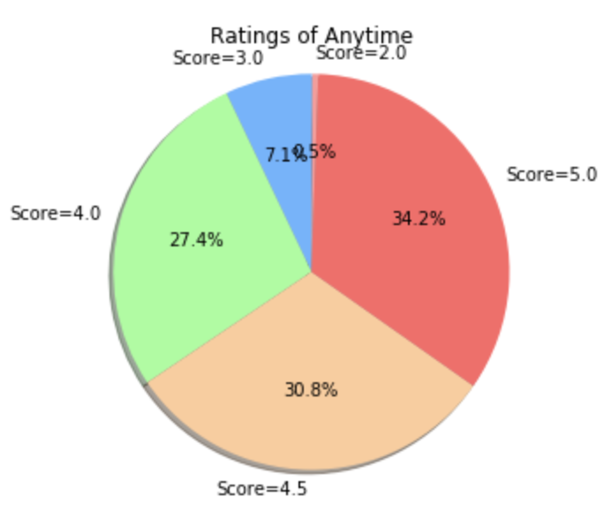
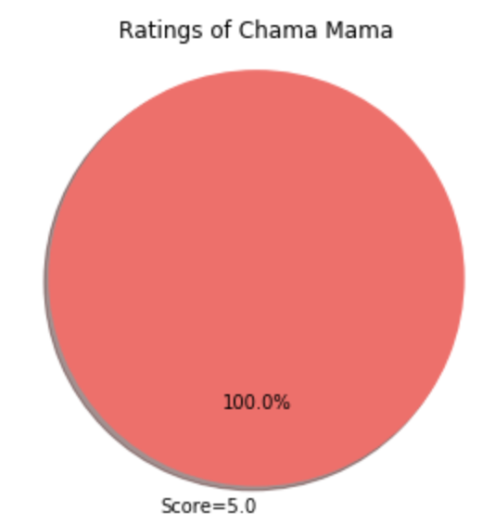
Top 5 rated restaurants
We got the top 5 restaurants with the highest average rating.

Slide 7
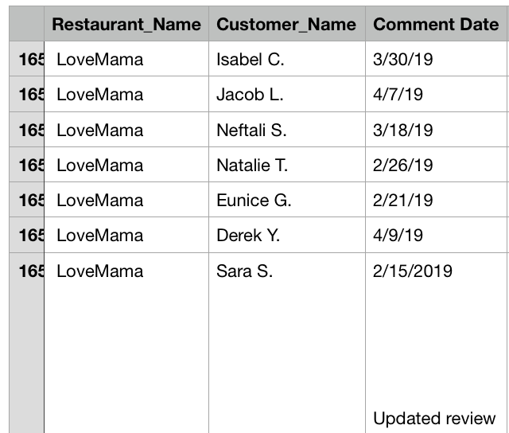
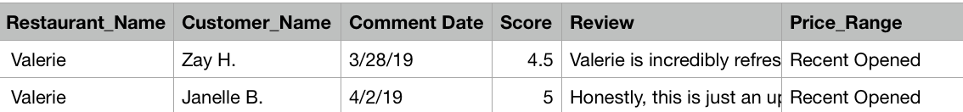
Data Cleansing & Data Wrangling
Dealing with missing value
We replaced the missing value(score) in our dataset with the average of score of each restaurant.
Remove “Updated review” in “Customer_Name” column.
Remove the restaurant with “Recent Opened” in “Price_Range” column.

Slide 8
Exploratory Data Analysis & Data Visualization
Notes:
delete

Slide 9
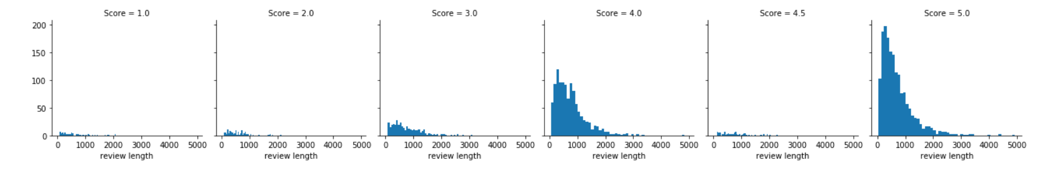
EDA
Distribution of Reviews
Seems like overall, the distribution of review length is similar across all the ratings. However, the number of reviews seems to be skewed a lot higher towards the 4-score and 5-score ratings. This may cause some issues later on in the process.

Slide 10
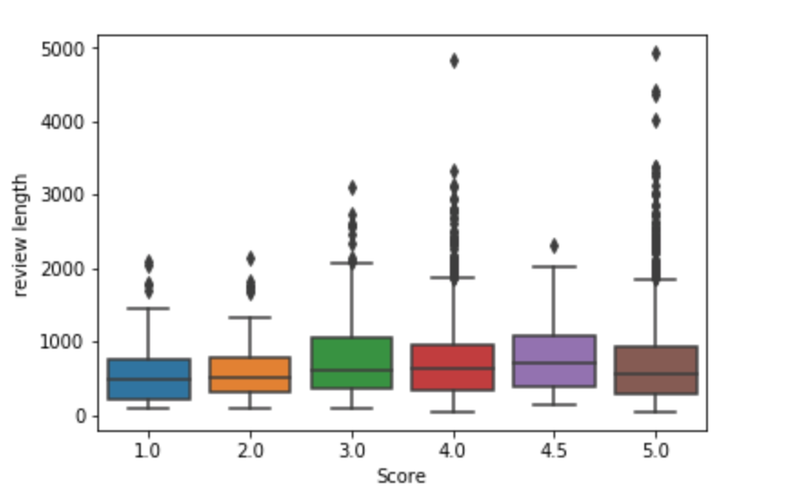
EDA
Length of Reviews
From the plot, the 3-score and 4.5-score ratings have much longer review, but there are many outliers (which can be seen as points above the boxes).
Review length won’t be such a useful feature to consider after all.
Notes:
From the plot, looks like the 3-score and 4.5-score ratings have much longer review, but there are many outliers (which can be seen as points above the boxes).

Slide 11
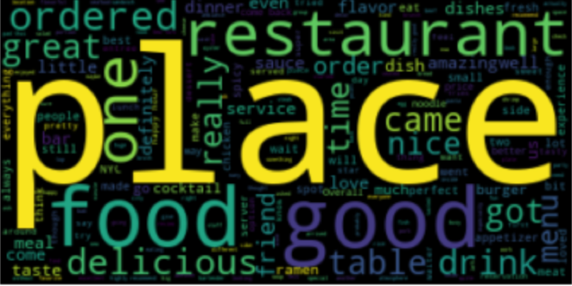
Generate Word cloud
Initially, we found out the top 10 words in the reviews. As we can see, those words are generally positive.
Notes:
Words like “Place,” “food,” “restaurant” and “good” stand out since they were used more frequently in the original text. As we can see, those words are generally positive. Thus, we can do further analysis on review clustering.

Slide 12
Topic Modeling

Slide 13
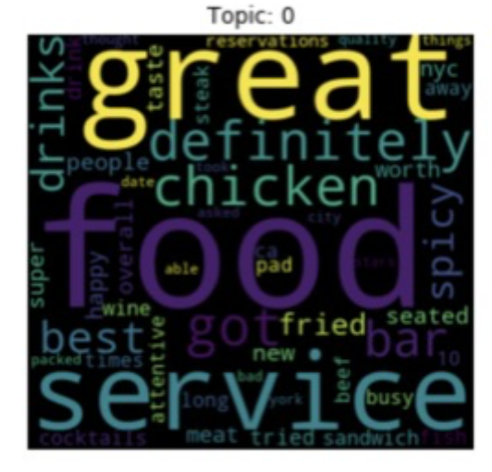
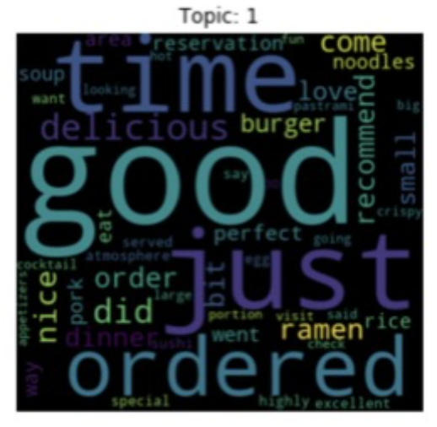
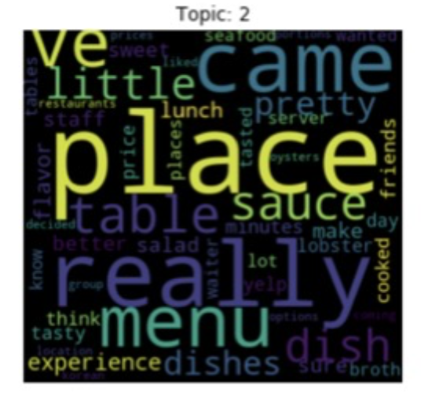
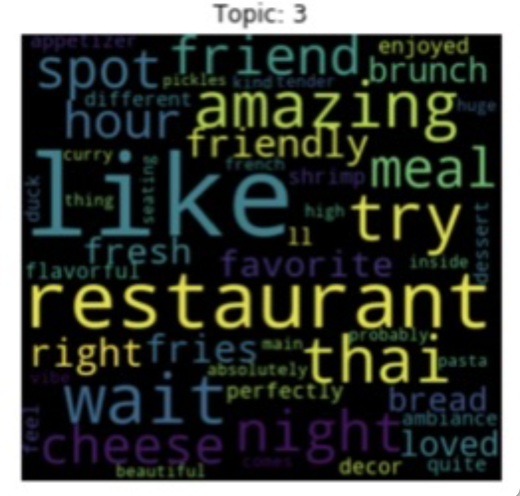
Latent Dirichlet allocation (LDA Model)
Features:
Topic 0: Service
Topic 1: Time
Topic 2: Place
Topic 3: Delicious
Feature words appears: count 1, no appear, count 0

Slide 14
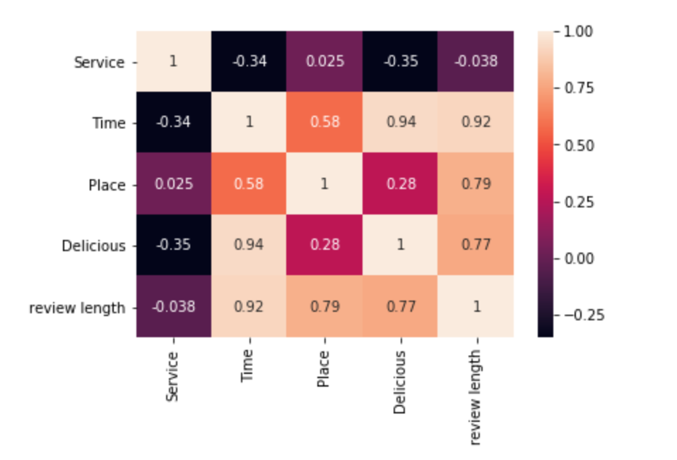
Feature Correlations
"Time" is strongly correlated with "Delicious";
"Time" is strongly correlated with "review length"

Slide 15
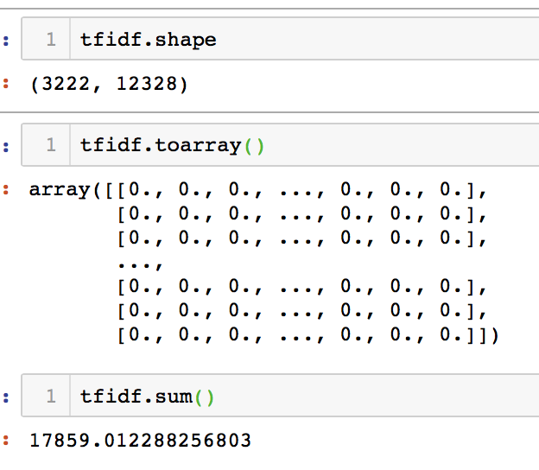
TF-IDF
Data PreProcessing
TF IDF is a numerical statistic that is intended to reflect how important a word is to a document in a collection or corpus.
Features:
Topic 0: Service
Topic 1: Time
Topic 2: Place
Topic 3: Delicious

Slide 16
Sentiment Analysis

Slide 17
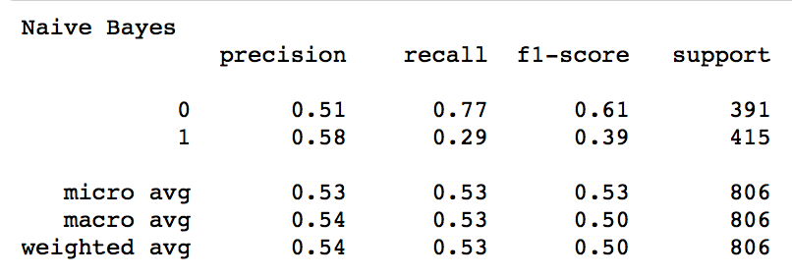
Sentiment Analysis
Naive Bayes
Naive Bayes:
Multinomial Naive Bayes is a specialised version of Naive Bayes designed more for text document.
We build a Multinomial Naive Bayes model and fit it to our training set
However, the performance of the Naive Bayes Model is low
Notes:
We firstly used the Multinomial Naive Bayes Model, which is designed for analyze text documents. Here, in the Classification Report,

Slide 18
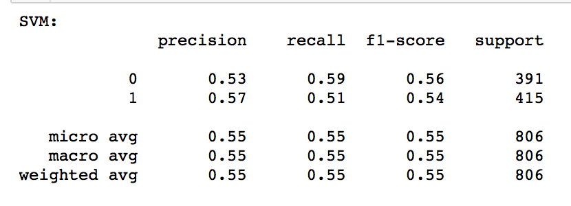
Sentiment Analysis
Support Vector Machine (SVM)
Support Vector Machine (SVM)
Multinomial Naive Bayes is a specialised version of Naive Bayes designed more for text document.
We build a Multinomial Naive Bayes model and fit it to our training set
The performance of the Support Vector Machine Model is

Slide 19
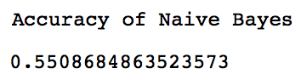
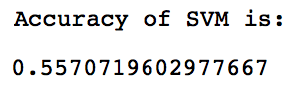
Accuracy Compare
Accuracy is used to measure model performance.
Naive Bayes
Result:
Support Vector Machine (SVM)
Result:
Comparison:
SVM has a slightly higher Accuracy
Both of the models doesn’t perform well
Online Review Bias
Notes:
The Reason why both models have rather low accuracy rate is that sometimes there is Online Review Bias, which means some reviews’ score are high simply because of politeness of the customers, where their negative reviews represent their true ideas.
Some reviews
Score is high
But it should be negative reviews

Slide 20
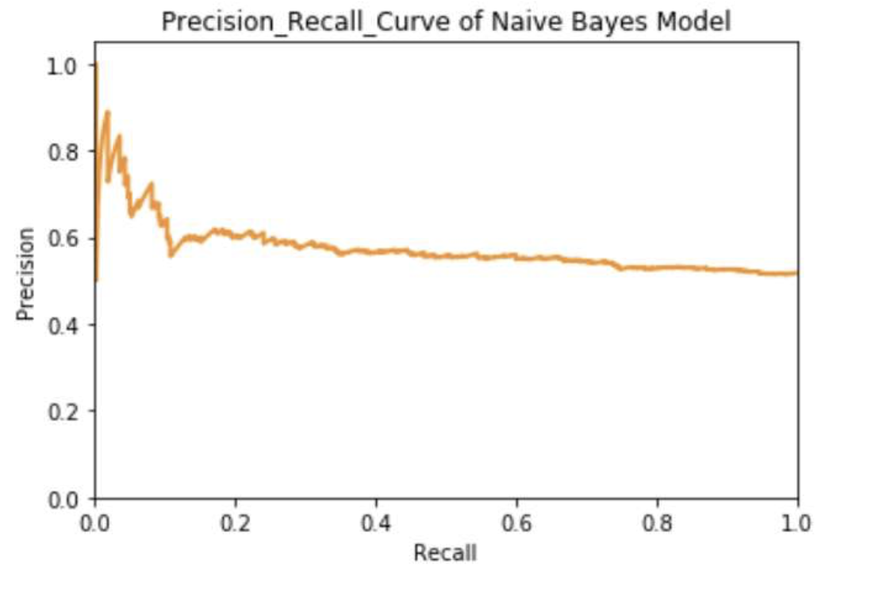
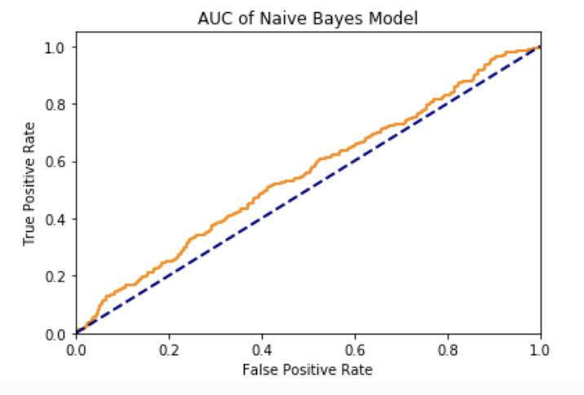
Model Compare
ROC & AUC
ROC :
Receiver operating characteristic (ROC) curve: plots the true positive rate (TPR) vs the false positive rate (FPR) as a function of the model’s threshold for classifying positives
AUC :
Area under the curve (AUC): metric to calculate the overall performance of a classification model based on area under the ROC curve

Slide 21

Future Work
More algorithms to be used
Provide in detail suggestions for restaurants to improve their profitability
Results using intuitive plots
Notes:
What steps have been taken to improve the performance of your model
Manually label the review
Reason :
Some reviews
Score is high
But it should be negative reviews

Slide 22
Thank You

